Slide 1
Hands-on Workshop:
Efficiency and Power Loss
Presented by:
<<Presenter’s name>>
<<presenter’s title>>
Notes:
10/7/2018

Slide 2
Outline
Efficiency and Power Loss Lab Exercise
  Efficiency concepts – Linear Regulator vs. Switching Regulator
  Construction Methods

Slide 3
Hands-On Session: Efficiency and Power Loss
Lab URL: https://wiki.analog.com/university/courses/electronics/efficiency_power_loss
Materials Required:
  ADALP2000 Parts Kit
  TO-220 Heat Sink, Aavid 7021 or other heat sink with thermal performance listed in datasheet, or 50x50mm section of copper-clad board.
  Mounting hardware for above.
  Rubber bands OR cyanoacrylate adhesive (to attach temperature sensor to regulator)
  0-24V, 1A power supply with current and voltage meters
Software Required:
  LTspice
Recommend working in groups of 3
Print Out (slides with “Print Me” at the top):
  Pictorial and schematic, double-sided
  Data worksheets
See Speaker Notes for preparation hints
Notes:
This lab is pretty straightforward, but there are some things that it’s beneficial to do ahead of time. The LT3080 leads fit into the breadboard more easily if they are twisted 90 degrees, so doing this ahead of time will save time in the classroom.
Similar with the temperature sensors – they can be glued to the LT3080, leads facing up, ahead of time. There are a couple of ways to make connections to the sensor, since it isn’t plugged into the breadboard. The preferred method would be to solder thin (>26 gauge) stranded wire to the terminals as shown, then cover with heat-shrink tubing. But this takes time. Another method would be to sacrifice a couple of breadboard leads, cutting off the pin, stripping wire, and twisting around the sensor leads. BUT… figure this out ahead of time, for sure!

Slide 4
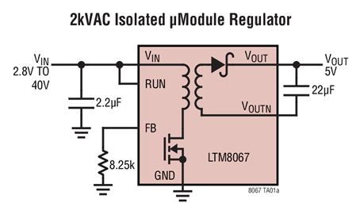
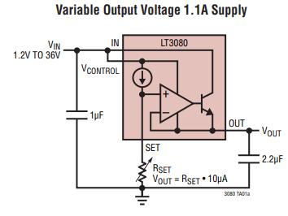
Efficiency and Power Loss: Not everything, but big things!
VS.
Flyback switching regulator is:
Efficient (w/ large ∆Vin-Vout)
Cool (relative to LDO)
Noisy(er)
Isolated
Linear regulator is:
Inefficient (w/ large ∆Vin-Vout)
Hot (Relative to switcher)
Quiet

Slide 5
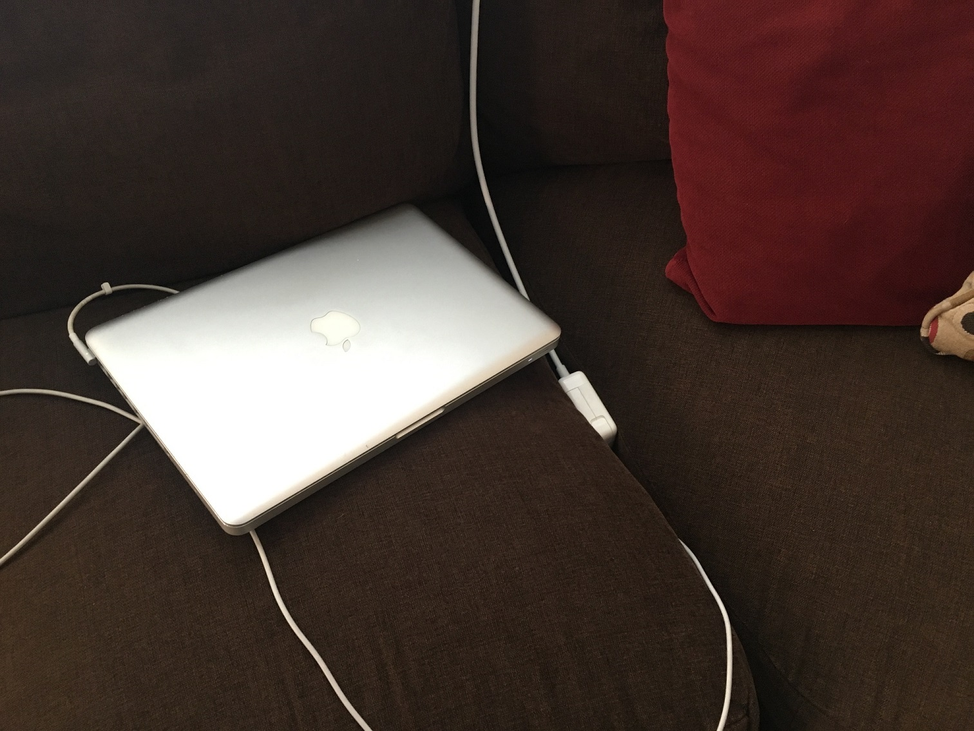
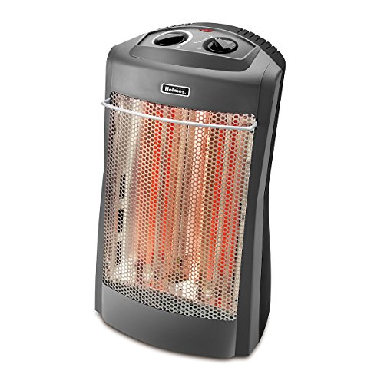
Efficiency vs. Power Loss
Efficiency is a nice basis for comparison.
Power loss is practical - power “lost”, or dissipated to the environment, represents power that is NOT available to do useful stuff, power that you have to get rid of somehow, and – you still have to pay for it.
An application where power loss is a good thing:
An application where power loss is a bad thing:
Notes:
https://www.electronicsweekly.com/news/products/analog/efficiency-can-be-misleading-says-ltcs-bob-dobkin-2011-10/

Slide 6
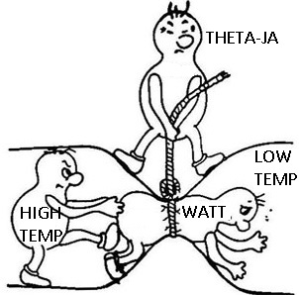
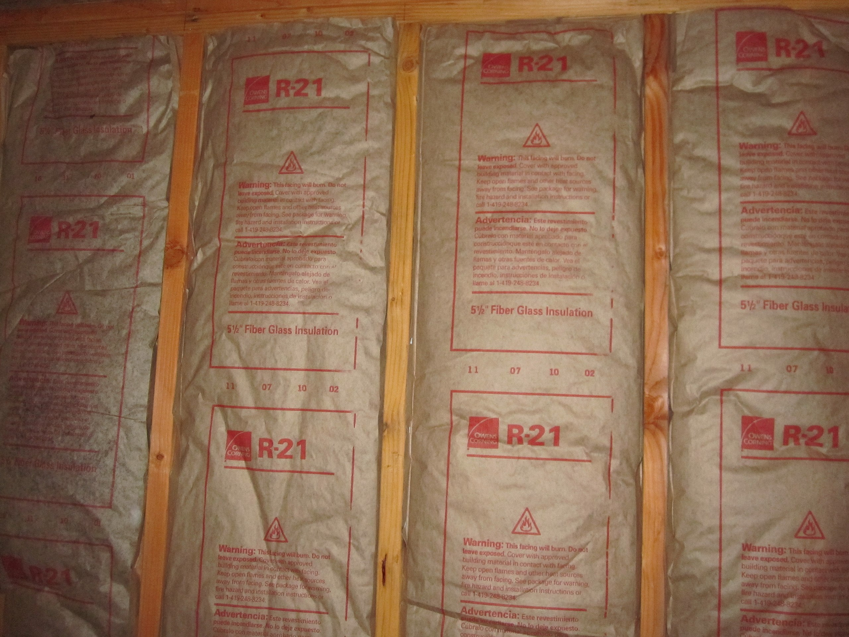
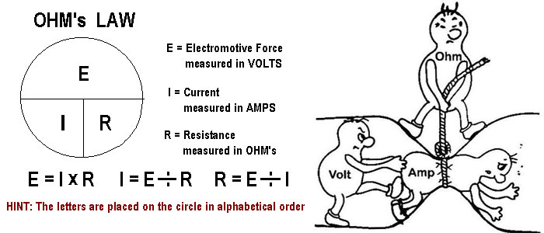
Thermal vs. Electrical vs. other resistance (Nature is lazy… the formulas are basically the same.)
IP units on thermal resistance (R-value): ft²· °F · h/BTU
SI units on thermal resistance: m² · K/W
For ICs, no area term – units on “theta-Jx” are C/W
  Can also be K/W

Slide 7
LT3080 “Low Dropout” regulator
You can’t exercise all corners at the same time:
36V input
1V output
1.1A output current
(36V-1V)*1.1A = 38.5W
What’s limiting??
ϴJA = 40C/W (TO-220 package)
Tjmax = 125C
38.5W * 40C/W = 1540C rise!!
So even if you had energy to spare and didn’t care, the part would catch on fire.
The LT3080 will always “burn” (Vin-Vout) x Iout as heat.

Slide 8
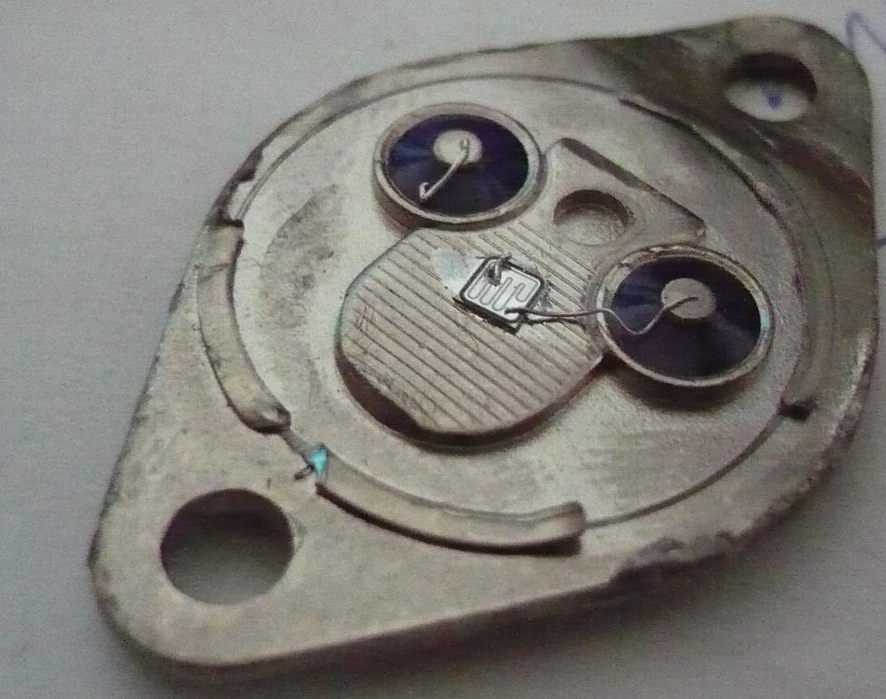
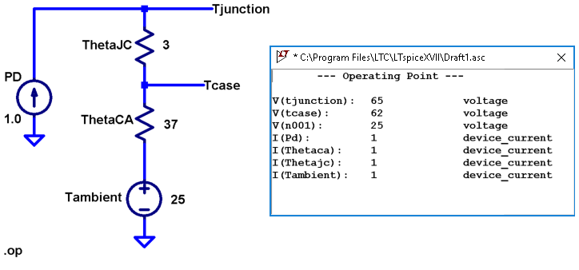
Thermal Resistance Primer
https://www.eevblog.com/forum/projects/opening-a-to-3-without-damaging-it/
Bolt a big enough heat sink on the back (case)…
…to keep this little guy cool

Slide 9
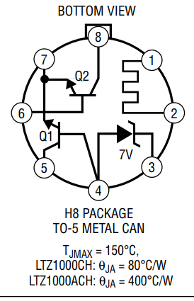
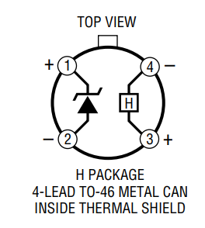
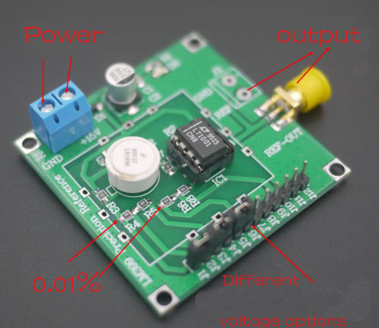
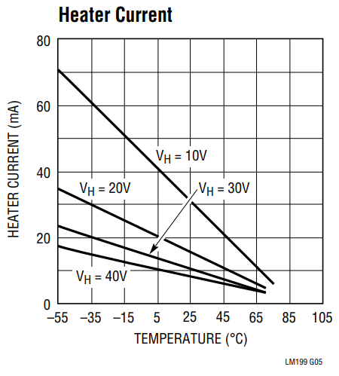
Digression: Do we ever INTENTIONALLY increase Theta-JA?
LT399 Precision Reference has a built-in heater, comes with plastic case
LTZ1000A Ultra Precision Reference “uses a proprietary die attach method to provide significantly higher thermal resistance” (Translation: foamy glue.)

Slide 10
LTspice Interlude…
LT3080 simulations with various input voltages, output currents
LTM8067 efficiency
Grab files here and run in LTspice:
https://minhaskamal.github.io/DownGit/#/home?url=https://github.com/analogdevicesinc/education_tools/tree/master/m2k/ltspice/efficency_power_loss_ltspice

Slide 11
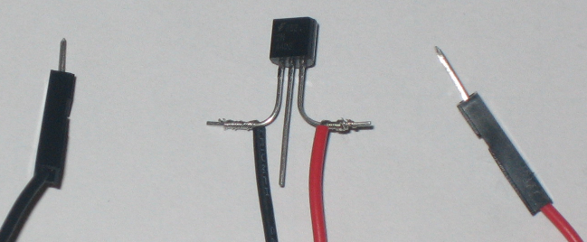
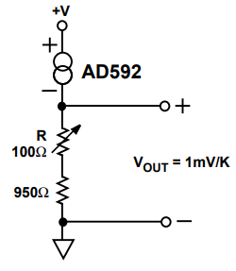
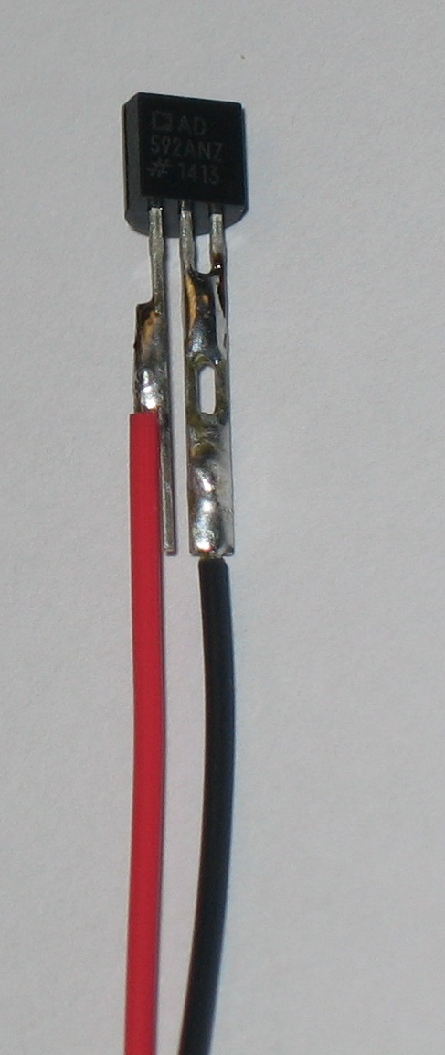
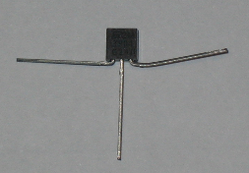
Measuring Temperature
External measurements – typically using thermocouples
We can use the AD592 from the parts kit.
Not terribly scientific, but useful for relative measurements and building intuition
No-solder method… sacrifice two breadboard leads. Gentle, wide bend in leads!!

Slide 12
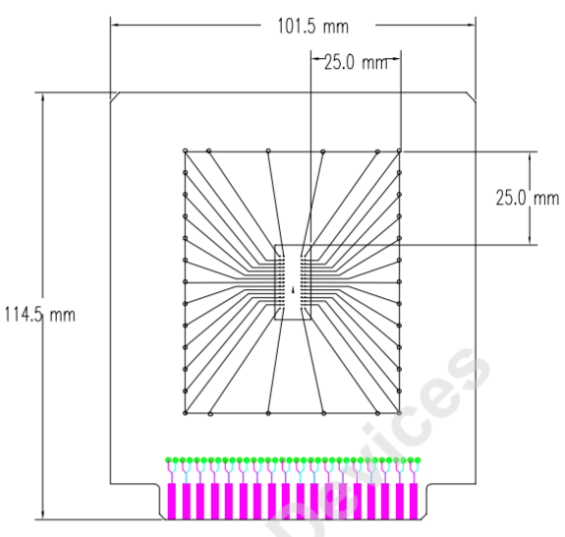
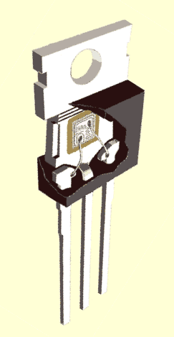
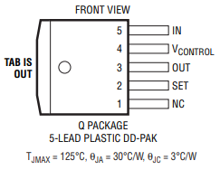
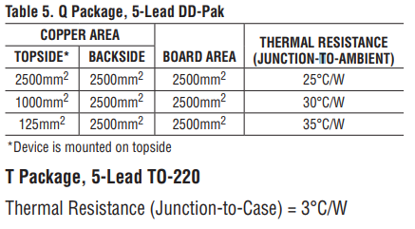
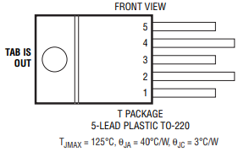
LT3080 Thermal Situation (have a look at your LT3080 from parts kit)
ϴ_{JC}: A theoretical minimum, with the part mounted to a big block of copper
ϴ_{JA}: Worst-case; measured with a thermally terrible board layout, on purpose.
ϴ_{JC}+ my ϴ_{CA} = ϴ_{MyDesign}
Your design is somewhere in between
Image from JESD51-9
Image from this article: http://www.johnhearfield.com/Eng/Heatsinks.htm

Slide 13
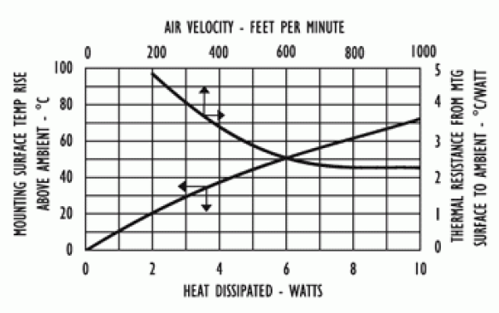
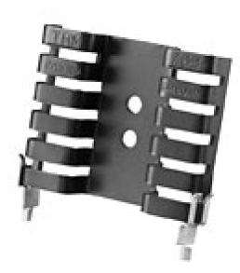
myϴ_{CA} – Aavid 7021 heat sink
Yup, even a bent piece of metal needs a datasheet.
Why does slope decrease (better thermal performance) at high power?
What happens at VERY high air speeds?
Still air resistance ~10C/W
Notes:
The slope of the still-air line is essentially theta-CA. But why does it flatten out? Two reasons:
Stefan–Boltzmann law – radiation heat loss is proportional to the FOURTH POWER of absolute temperature – as the temperature of the (black, high-emissivity) heat sink increases, it loses more heat via radiation.
As the air around the heat sink heats up, it begins to move (free convection.) The slots form little “chimneys”, stimulating airflow. You will notice that heat sinks on equipment will nearly always be placed in a VERTICAL orientation, for this reason.
For the forced-convection line, does higher airspeed always equal better cooling? (See next slide for answer…)

Slide 14
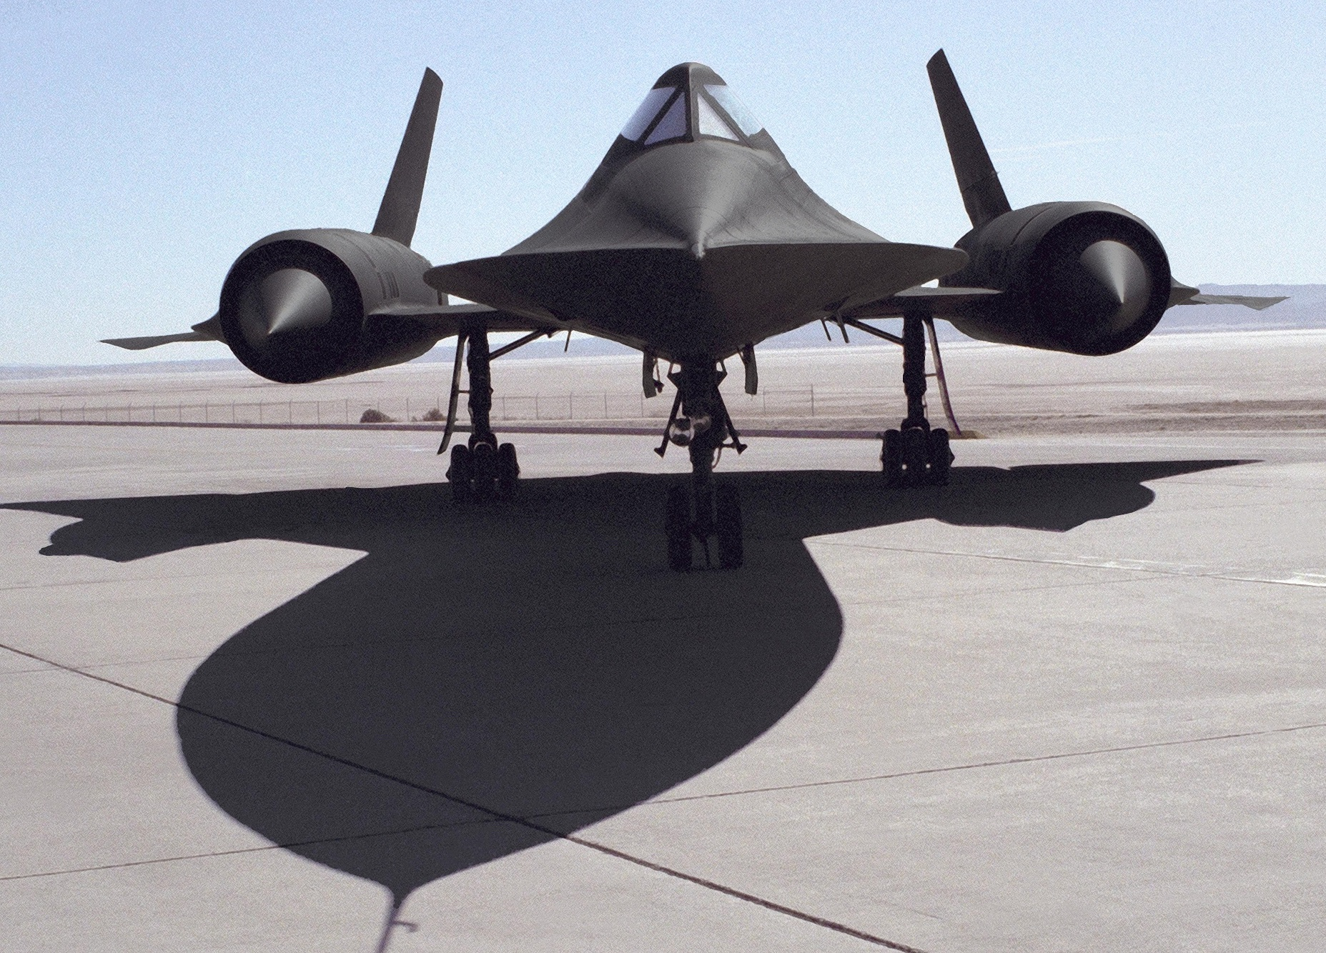
Convective cooling: not so effective at Mach 3…
From: Design and Development of the Blackbird: Challenges and Lessons Learned
The Blackbirds earned their nickname because they were coated with a high-emissivity black paint for improved heat radiation, thus reducing thermal stresses on the airframe. The first A-12 initially flew unpainted. Early models in the A-12 and YF-12A series were subsequently painted black only on the periphery of the airframe where heating was greatest: on chines, leading and trailing edges, and rudders.
Engineers soon realized it would be advantageous to take advantage of Kirchoff’s law of Radiation that describes how a good heat absorber, such as a black body any extremely dark object), is also an efficient heat emitter. Although convective heating decreases with increasing altitude, heat radiation occurs independently of altitude. Therefore, in late 1963, Skunk Works engineers decided to take advantage of the black-body radiation phenomenon by painting the A-12 fleet and subsequent variants entirely black.
https://ntrs.nasa.gov/archive/nasa/casi.ntrs.nasa.gov/20090007797.pdf
Notes:
Not at Mach 3 ☺

Slide 15
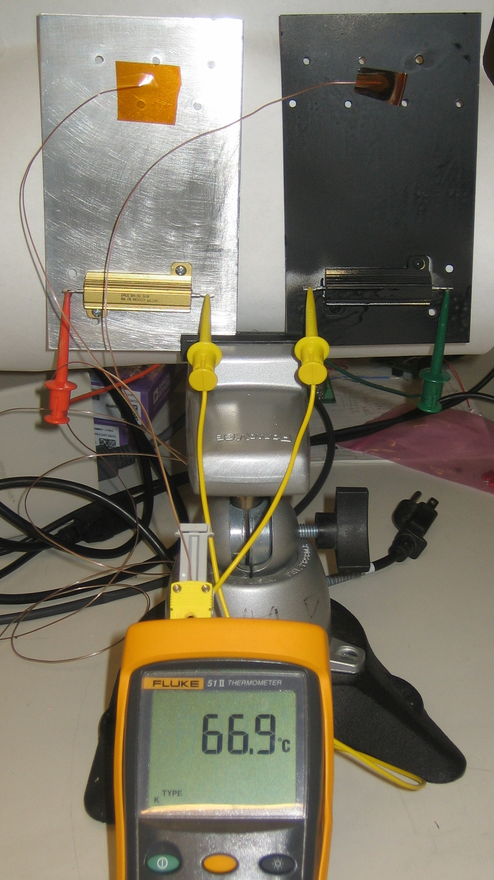
Let’s test that theory…
12V²/8Ω = 18W
Silver @ 72C (47C rise)
Black @ 57C (32C rise)
(15C cooler!!)
Notes:
An experiment to demonstrate the increased cooling efficiency of a high-emissivity heat sink.

Slide 16
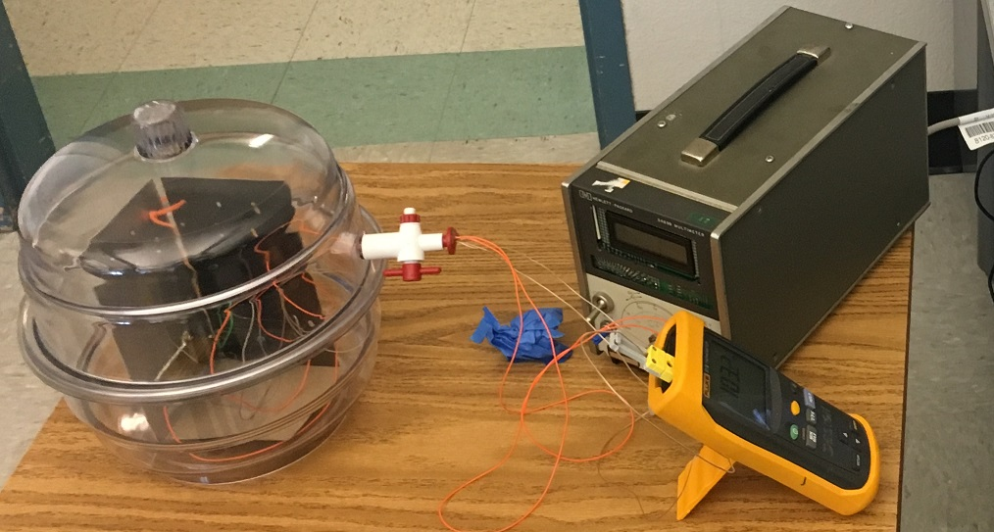
Same experiment… in a vacuum!
Take away convection, so only radiation is the only way to get rid of heat.
In air (25C ambient):
  Silver rises to 75C
  Black rises to 60C
    (15C cooler)
In a vacuum:
  Silver rises to 130C
  Black rises to 90C
    40C cooler!!
Notes:
Same experiment run in a vacuum!

Slide 17
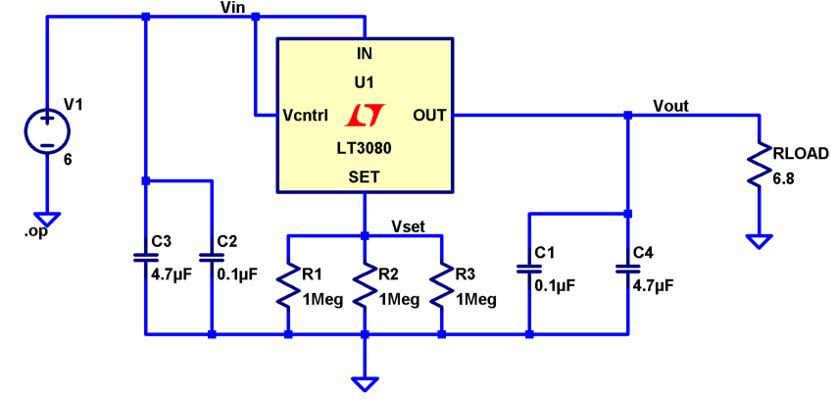
Time to build!
Print Me!
Pin 5
Pin 3
Pin 4
Pin 2

Slide 18
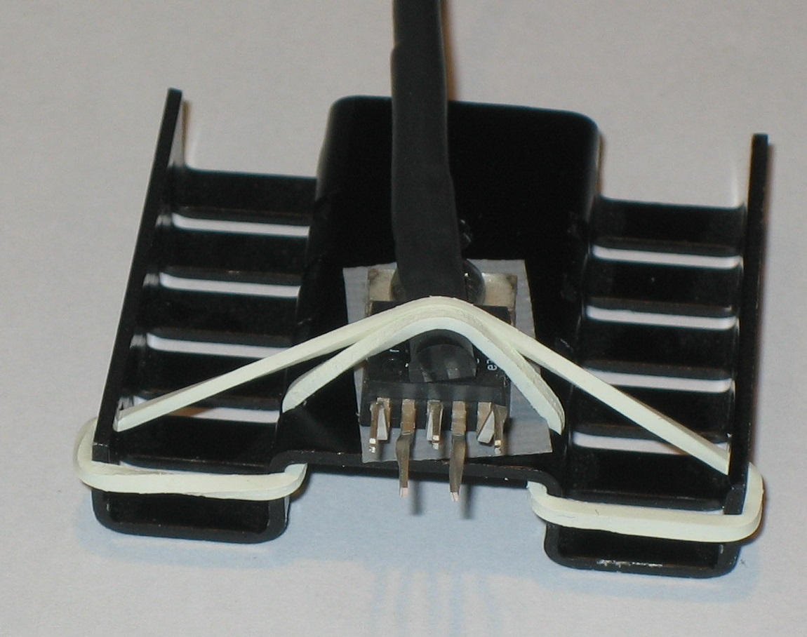
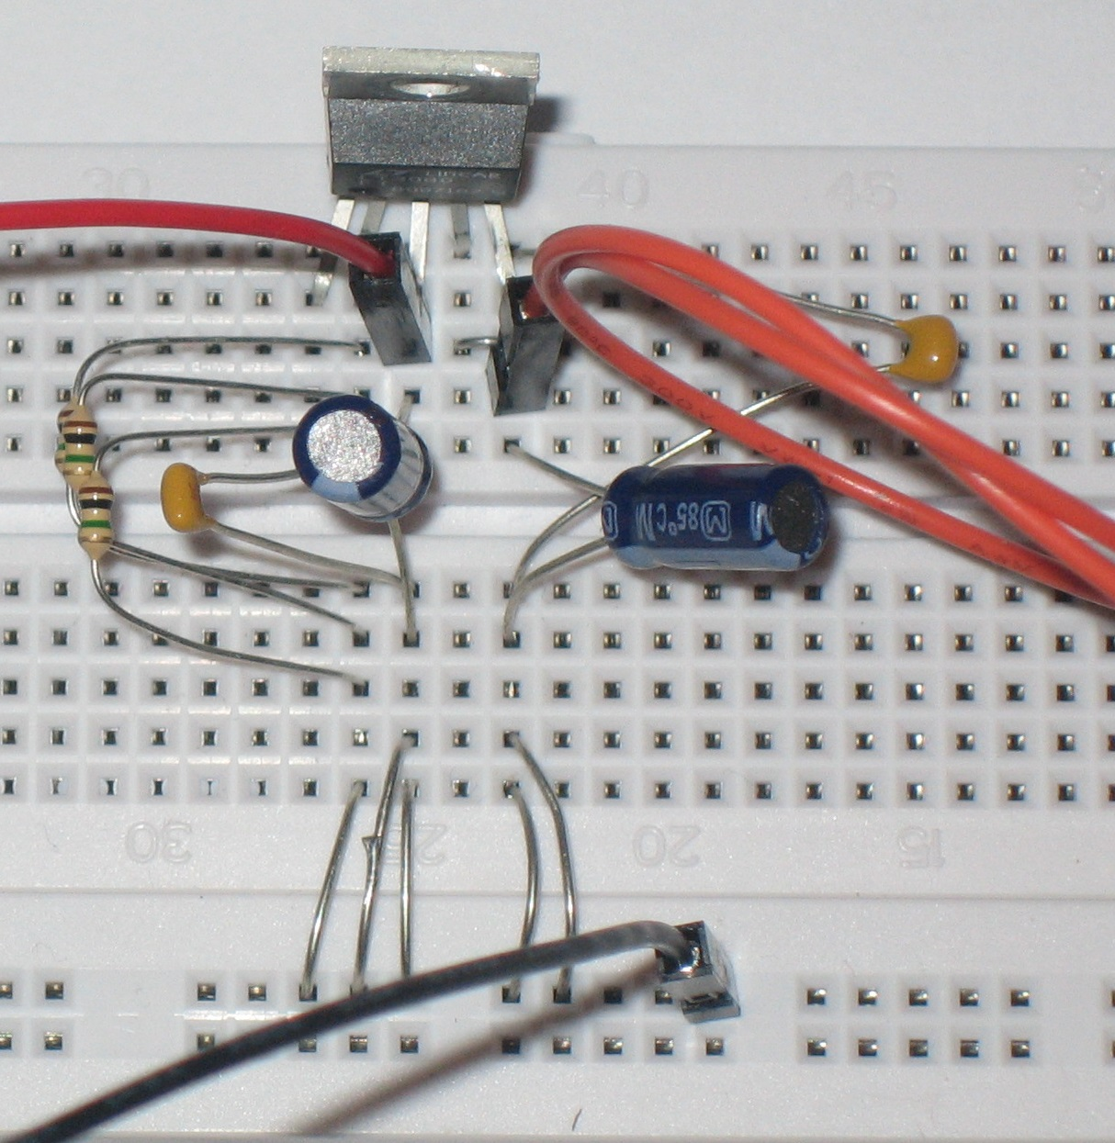
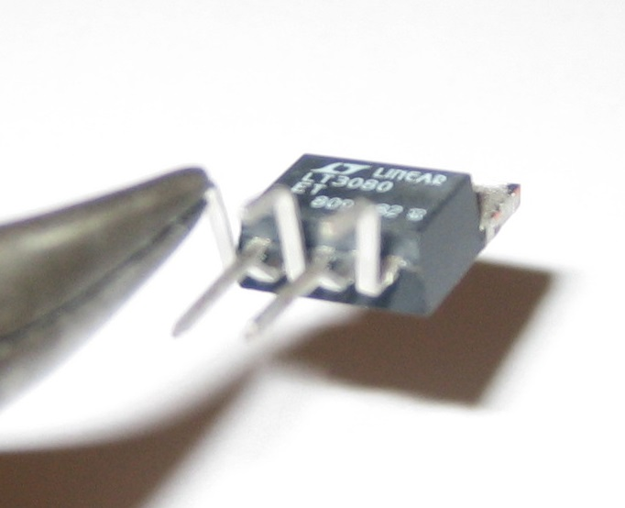
Visual…
Print Me!
LT3080 pin 1 in bredboard col. 35
Jump pins 4,5, this is the input
Pin 3 is output
Temp Sensor Mounting (Cyanoacrylate glue also works and is more rugged)
IMPORTANT! We discovered during the workshop that ground strips are split at the center… jump or keep to one side.
Ground set R, caps separately, 2 wires for each cap
Twist leads 90º

Slide 19
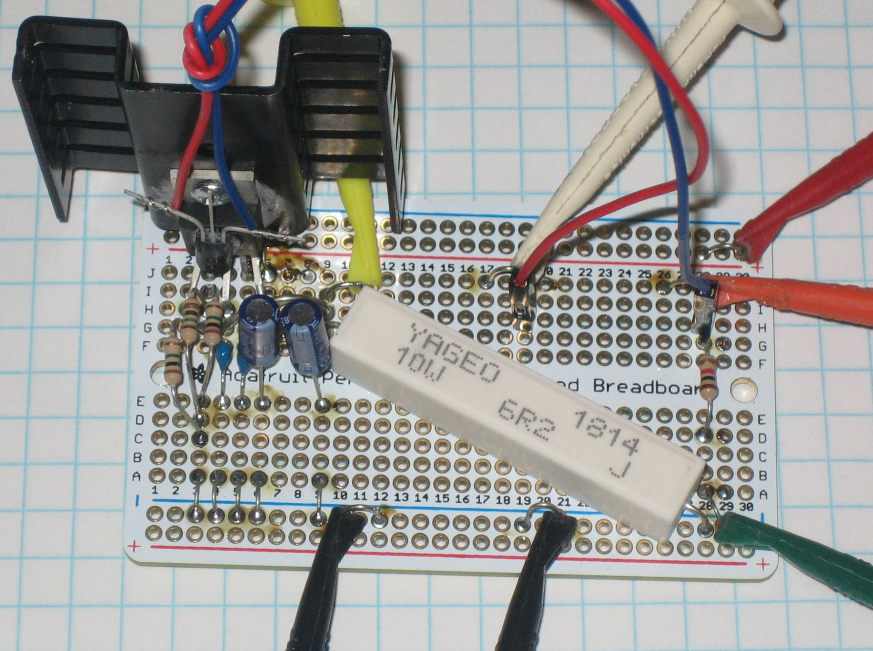
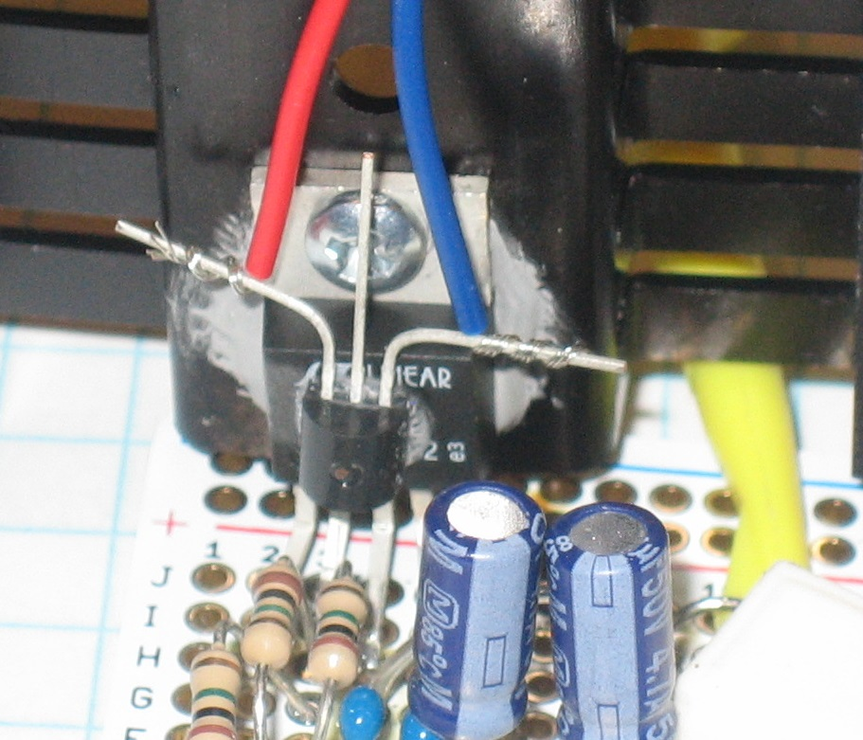
Visual, alternate construction…
Print Me!
LT3080 Output
Temp Sensor Power (~9V)
Temp Sensor Mounting (Cyanoacrylate glue)
LT3080 5-10V Input
Temp Sensor Output
You can never have too many grounds ☺

Slide 20
LT3080 efficiency measurements
Build up LT3080 circuits, 2.5V output, 6.8-ohm load resistor
Measure efficiency with 6V in
  Measure load current
  Measure input current (are they different?)
  Measure power delivered to load (V*I)
  Measure power dissipated in LT3080
  Measure temperature rise
Increase input to 10V
  Repeat measurements
What would happen if we increased input to 24V?

Slide 21
Measurement Worksheet – LT3080
Print Me!
Input Voltage | Output Voltage | Input Current | Output Current | LT3080 pwr dissipation | Load pwr dissipation | Efficiency | Temp. rise | Theta-JA
0V (discon-nected) | N/A | N/A | N/A | N/A | N/A | N/A | (initial temp) | N/A
5V
10V
Theta-JA = temperature rise / (power dissipation * 0.8 “adjustment factor”)

Slide 22
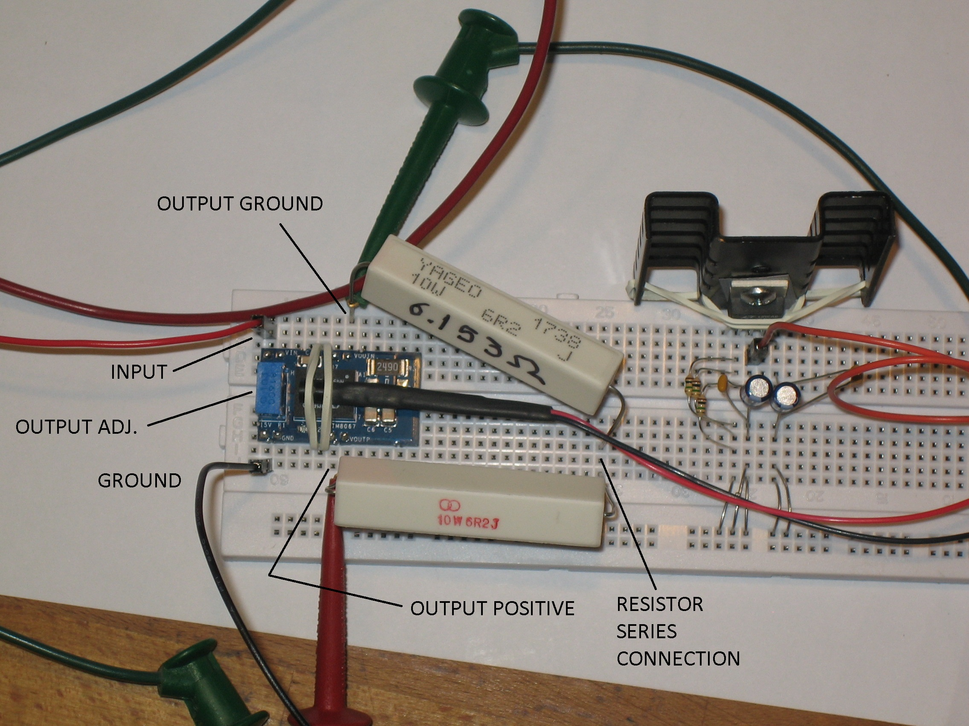
LTM8067 Isolated Flyback
Print Me!
Work with a partner – need two 6.2 ohm resistors in series for load
Apply 10V input, set output to 3.3V
Measure input current vs. input voltage, all the way up to 24Vin
Does the module get hot?

Slide 23
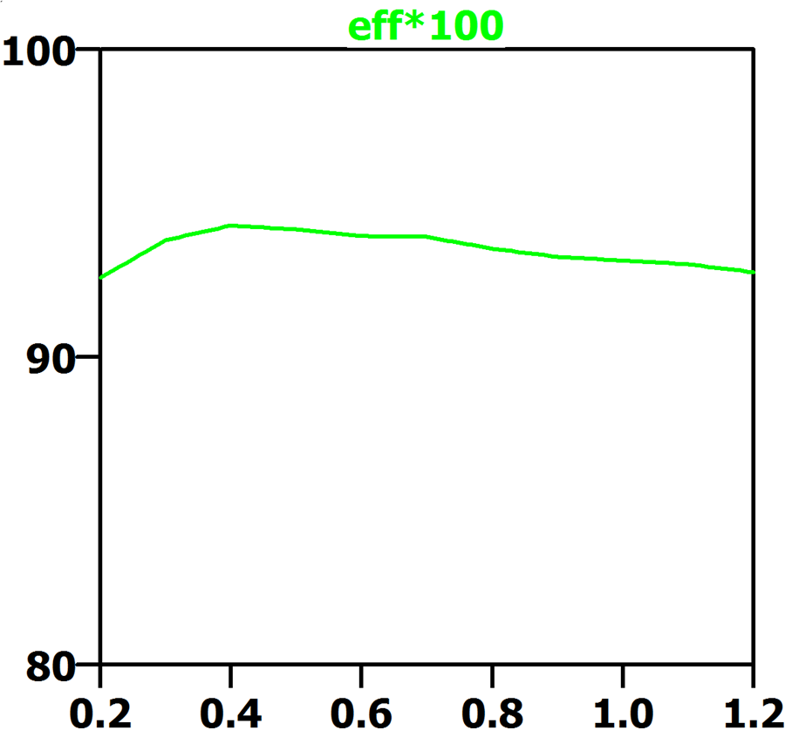
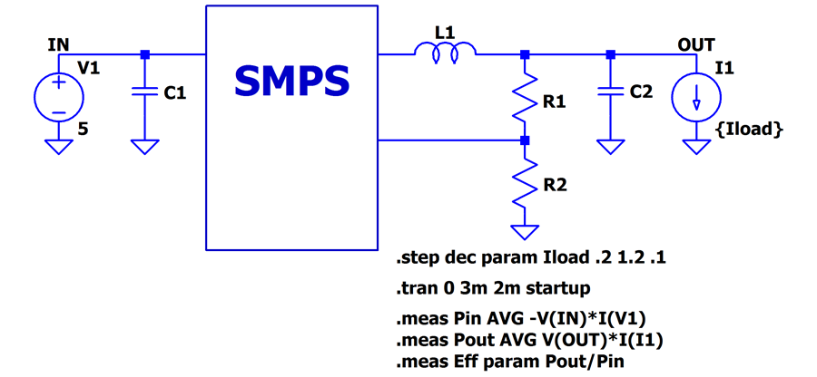
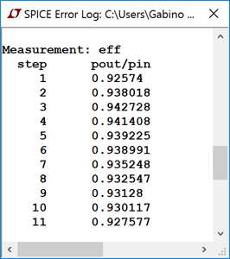
Efficiency in LTspice
http://www.analog.com/en/technical-articles/ltspice-using-meas-and-step-commands-to-calculate-efficiency.html

Slide 24
Measurement Worksheet – LTM8067
Print Me!
Input Voltage | Output Voltage | Input Current | Output Current | LT3080 pwr dissipation | Load pwr dissipation | Efficiency | Temperature rise
10V
24V

Slide 25
Acknowledgements

Slide 26
Thanks!

